Slide 1
Day1- MEAN Basics

Slide 2
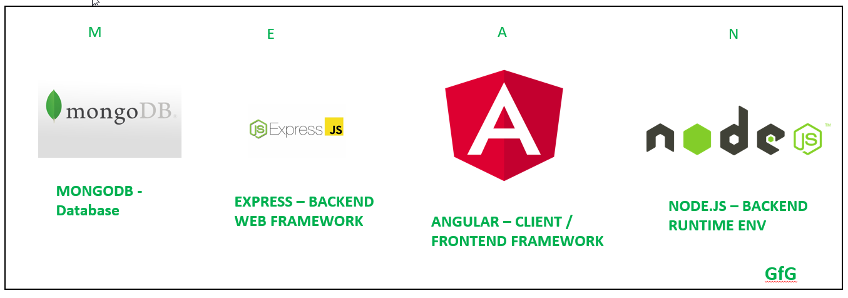

Slide 3
1. Basics of Web Development
Web development involves building websites and web applications. It consists of three main layers:
Frontend (Client-Side Development): The part users interact with, built using HTML, CSS, and JavaScript.
Backend (Server-Side Development): Handles data processing, logic, and database interactions, using languages like Node.js, Python, Java, or PHP.
Database: Stores website data, commonly using MySQL, PostgreSQL, or MongoDB.

Slide 4
Core Technologies:
HTML (HyperText Markup Language): The structure of web pages.
CSS (Cascading Style Sheets): The styling and layout.
JavaScript: Adds interactivity.

Slide 5
Web Design Principles
Good web design follows certain principles:
Clarity and Simplicity: Avoid clutter; keep designs clean and user-friendly.
Consistency: Use uniform colors, fonts, and layouts.
Visual Hierarchy: Use size, contrast, and spacing to highlight important elements.
Navigation: Menus should be easy to find and use.
Accessibility: Ensure content is readable for all users, including those with disabilities.
Performance Optimization: Minimize load times by compressing images and optimizing code.

Slide 6
Best Practices
Best practices:
Use semantic HTML for better SEO and accessibility.
Keep CSS and JavaScript optimized.
Ensure cross-browser compatibility.
Test responsiveness on different devices.

Slide 7
Understanding Responsive Web Design (RWD)
Responsive web design ensures a website looks good on all devices (desktops, tablets, and smartphones).
Key Techniques:
Flexible Layouts: Use percentages instead of fixed pixels for widths.
Media Queries: Apply different styles based on screen size.
Fluid Images: Use max-width: 100% to scale images automatically.

Slide 8
Mobile-First Approach
Instead of designing for desktops first, the mobile-first approach starts with the smallest screens and scales up.
Why Mobile-First?
Majority of users browse on mobile.
Improves performance.
Implementation Steps:
Start with a Mobile Layout: Design a simple interface for small screens.
Use Progressive Enhancement: Add more features for larger screens.
Optimize Performance: Reduce unnecessary elements for mobile users

Slide 9
Fundamentals of Bootstrap
Bootstrap is a popular front-end framework that makes web development faster and easier.
Key Features:
Grid System: A flexible layout system for responsive design.
Pre-built Components: Buttons, modals, forms, and more.

Slide 10
Basics of HTML5
HTML5 (HyperText Markup Language 5) is the latest version of HTML, used to structure web pages.
Key Features of HTML5
Semantic Elements: <header>, <article>, <section>, <footer> improve readability.
Multimedia Support: Native support for <audio> and <video>.
Form Enhancements: New input types like email, date, and number.
Canvas & SVG: Graphics drawing without third-party plugins.

Slide 11
Sample HTML 5 code
<!DOCTYPE html>
<html lang="en">
<head>
<meta charset="UTF-8">
<meta name="viewport" content="width=device-width, initial-scale=1.0">
<title>My First HTML5 Page</title>
</head>
<body>
<header>
<h1>Welcome to HTML5</h1>
</header>
<section>
<p>This is a basic webpage structure.</p>
</section>
<footer>
<p>&copy; 2025 My Website</p>
</footer>
</body>
</html>

Slide 12
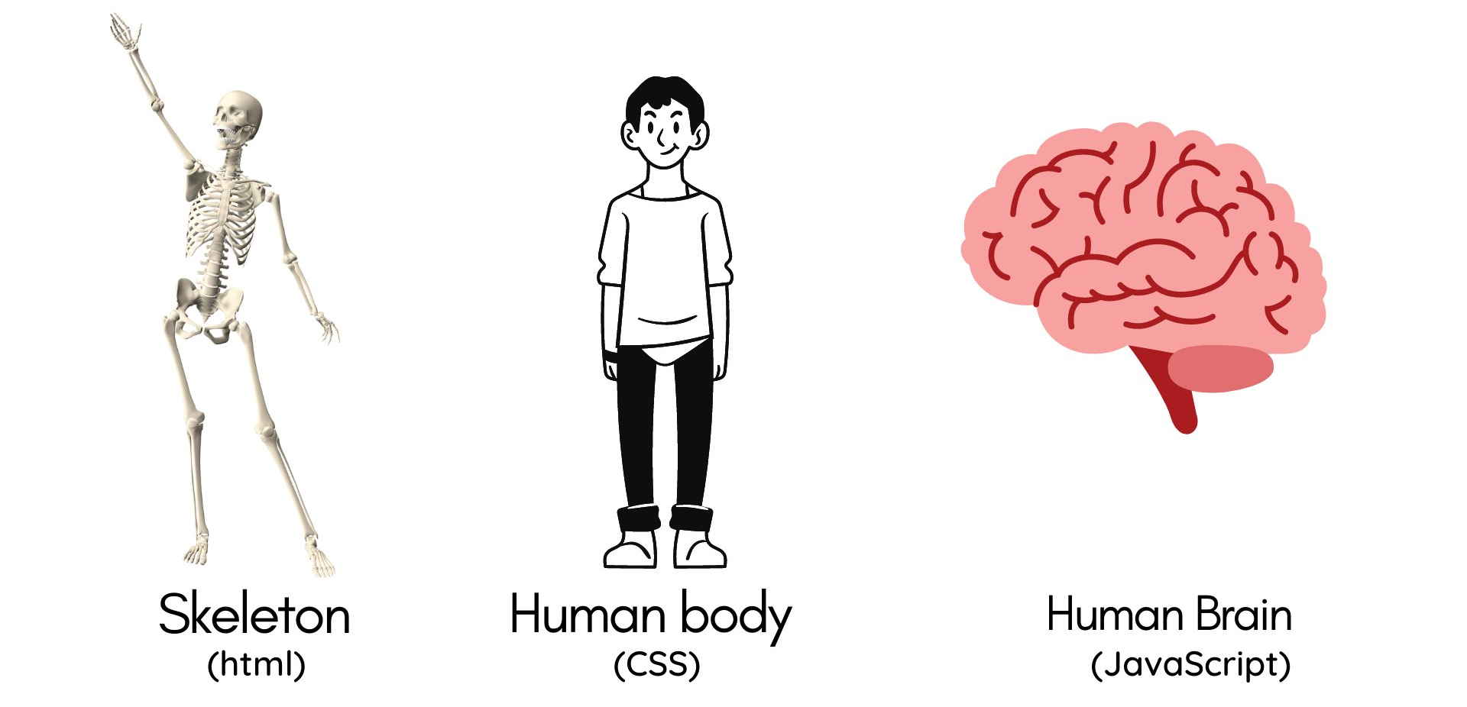
HTML, CSS,JS

Slide 13
Basics of CSS3
CSS3 (Cascading Style Sheets 3) is used to style HTML elements.
Key Features of CSS3
Selectors & Pseudo-classes: More control over elements (:hover, :nth-child()).
Flexbox & Grid: Modern layout techniques.
Animations & Transitions: Smooth UI interactions.
Media Queries: Responsive design.

Slide 14
Basics of CSS3
CSS3 (Cascading Style Sheets 3) is used to style HTML elements.
Key Features of CSS3
Selectors & Pseudo-classes: More control over elements (:hover, :nth-child()).
Flexbox & Grid: Modern layout techniques.
Animations & Transitions: Smooth UI interactions.
Media Queries: Responsive design.

Slide 15
Testing and Debugging using Developer Tools
Key Features
Elements Tab: View and edit HTML/CSS in real-time.
Console Tab: Shows errors and allows testing JavaScript.
Network Tab: Checks page load speed and resources.
Sources Tab: Debug JavaScript with breakpoints

Slide 16
JS
JavaScript is a high-level, interpreted programming language used for making web pages interactive. It runs in the browser and supports both functional and object-oriented programming.
Sample code:
console.log("Hello, JavaScript!");

Slide 17
Asynchronous Programming in JavaScript
Asynchronous programming allows JavaScript to execute non-blocking code, meaning the browser remains responsive while waiting for tasks like API calls or file reading.
Synchronous vs. Asynchronous
Synchronous: Executes line by line.
Asynchronous: Executes tasks in the background while continuing other operations.

Slide 18
sample
console.log("Start");
setTimeout(() => {
console.log("Asynchronous Task");
}, 2000);
console.log("End");

Slide 19
Callbacks in JavaScript
A callback is a function passed as an argument to another function.
function greet(name, callback) {
console.log("Hello, " + name);
callback();
}
function sayGoodbye() {
console.log("Goodbye!");
}
greet("John", sayGoodbye);
Output:
Hello, John
Goodbye!

Slide 20
Object-Oriented Programming (OOP) in JavaScript
JavaScript supports OOP using prototypes and classes.
class Person {
constructor(name, age) {
this.name = name;
this.age = age;
}
greet() {
console.log(`Hello, my name is ${this.name} and I am ${this.age} years old.`);
}
}
const person1 = new Person("Alice", 25);
person1.greet();
Output:
Hello, my name is Alice and I am 25 years old.

Slide 21
OOP Concepts in JavaScript
Encapsulation: Data is bundled inside objects.
Inheritance: One class can extend another.
Polymorphism: Methods can be overridden.
Abstraction: Hiding implementation details

Slide 22

DOM Structure
document.getElementById("btn").addEventListener("click", function() {
alert("Button clicked!");
});

Slide 23
Error Handling
JavaScript provides try-catch for handling errors.
try {
let result = x / 2; // x is not defined
} catch (error) {
console.log("Error occurred:", error.message);
}

Slide 24
Basics of Node.js Architecture
Node.js is a runtime environment that allows JavaScript to run outside the browser.
It is built on Google Chrome's V8 JavaScript engine and uses a non-blocking, event-driven architecture, making it ideal for scalable applications.

Slide 25
Key Features of Node.js
Single-threaded, Non-blocking I/O (Handles multiple requests asynchronously
Event-driven (Uses event loop and callbacks)
Built-in Package Manager (NPM) (Easily install libraries)
Uses JavaScript (Full-stack development with JS for frontend and backend)

Slide 26
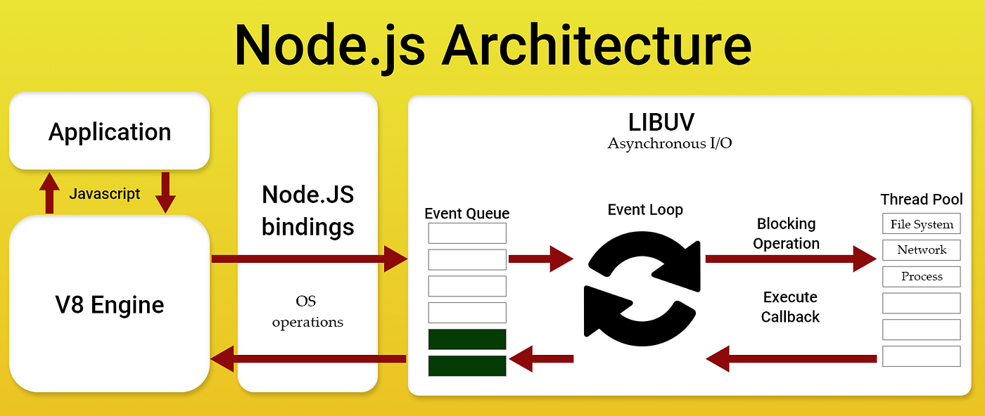

Slide 27
Node.js Architecture
Client Request: A user sends an HTTP request.
Event Loop: Handles requests asynchronously.
Thread Pool: Handles heavy operations (file access, database queries).
Response Sent: Data is processed and sent back to the client.

Slide 28
SQL vs NoSQL Databases
SQL (Relational Databases)
Structured, tabular format (rows & columns).
Uses Structured Query Language (SQL).
ACID-compliant (Atomicity, Consistency, Isolation, Durability).
Examples: MySQL, PostgreSQL, Microsoft SQL Server.
NoSQL (Non-Relational Databases)
Flexible schema (JSON, key-value, columnar, graph-based).
Scales horizontally (easier to distribute data across servers).
Ideal for real-time applications.
Examples: MongoDB, Cassandra, Redis, Firebase.

Slide 29
Common NoSQL Best Practices
Use Indexing Efficiently: Avoid full document scans by indexing frequently queried fields.
Denormalization: Store redundant data to avoid joins (since NoSQL lacks traditional joins).
Sharding for Scalability: Distribute data across multiple servers.
Optimize Read vs. Write Operations: Choose the right storage format for high-performance queries.

